Slide 1

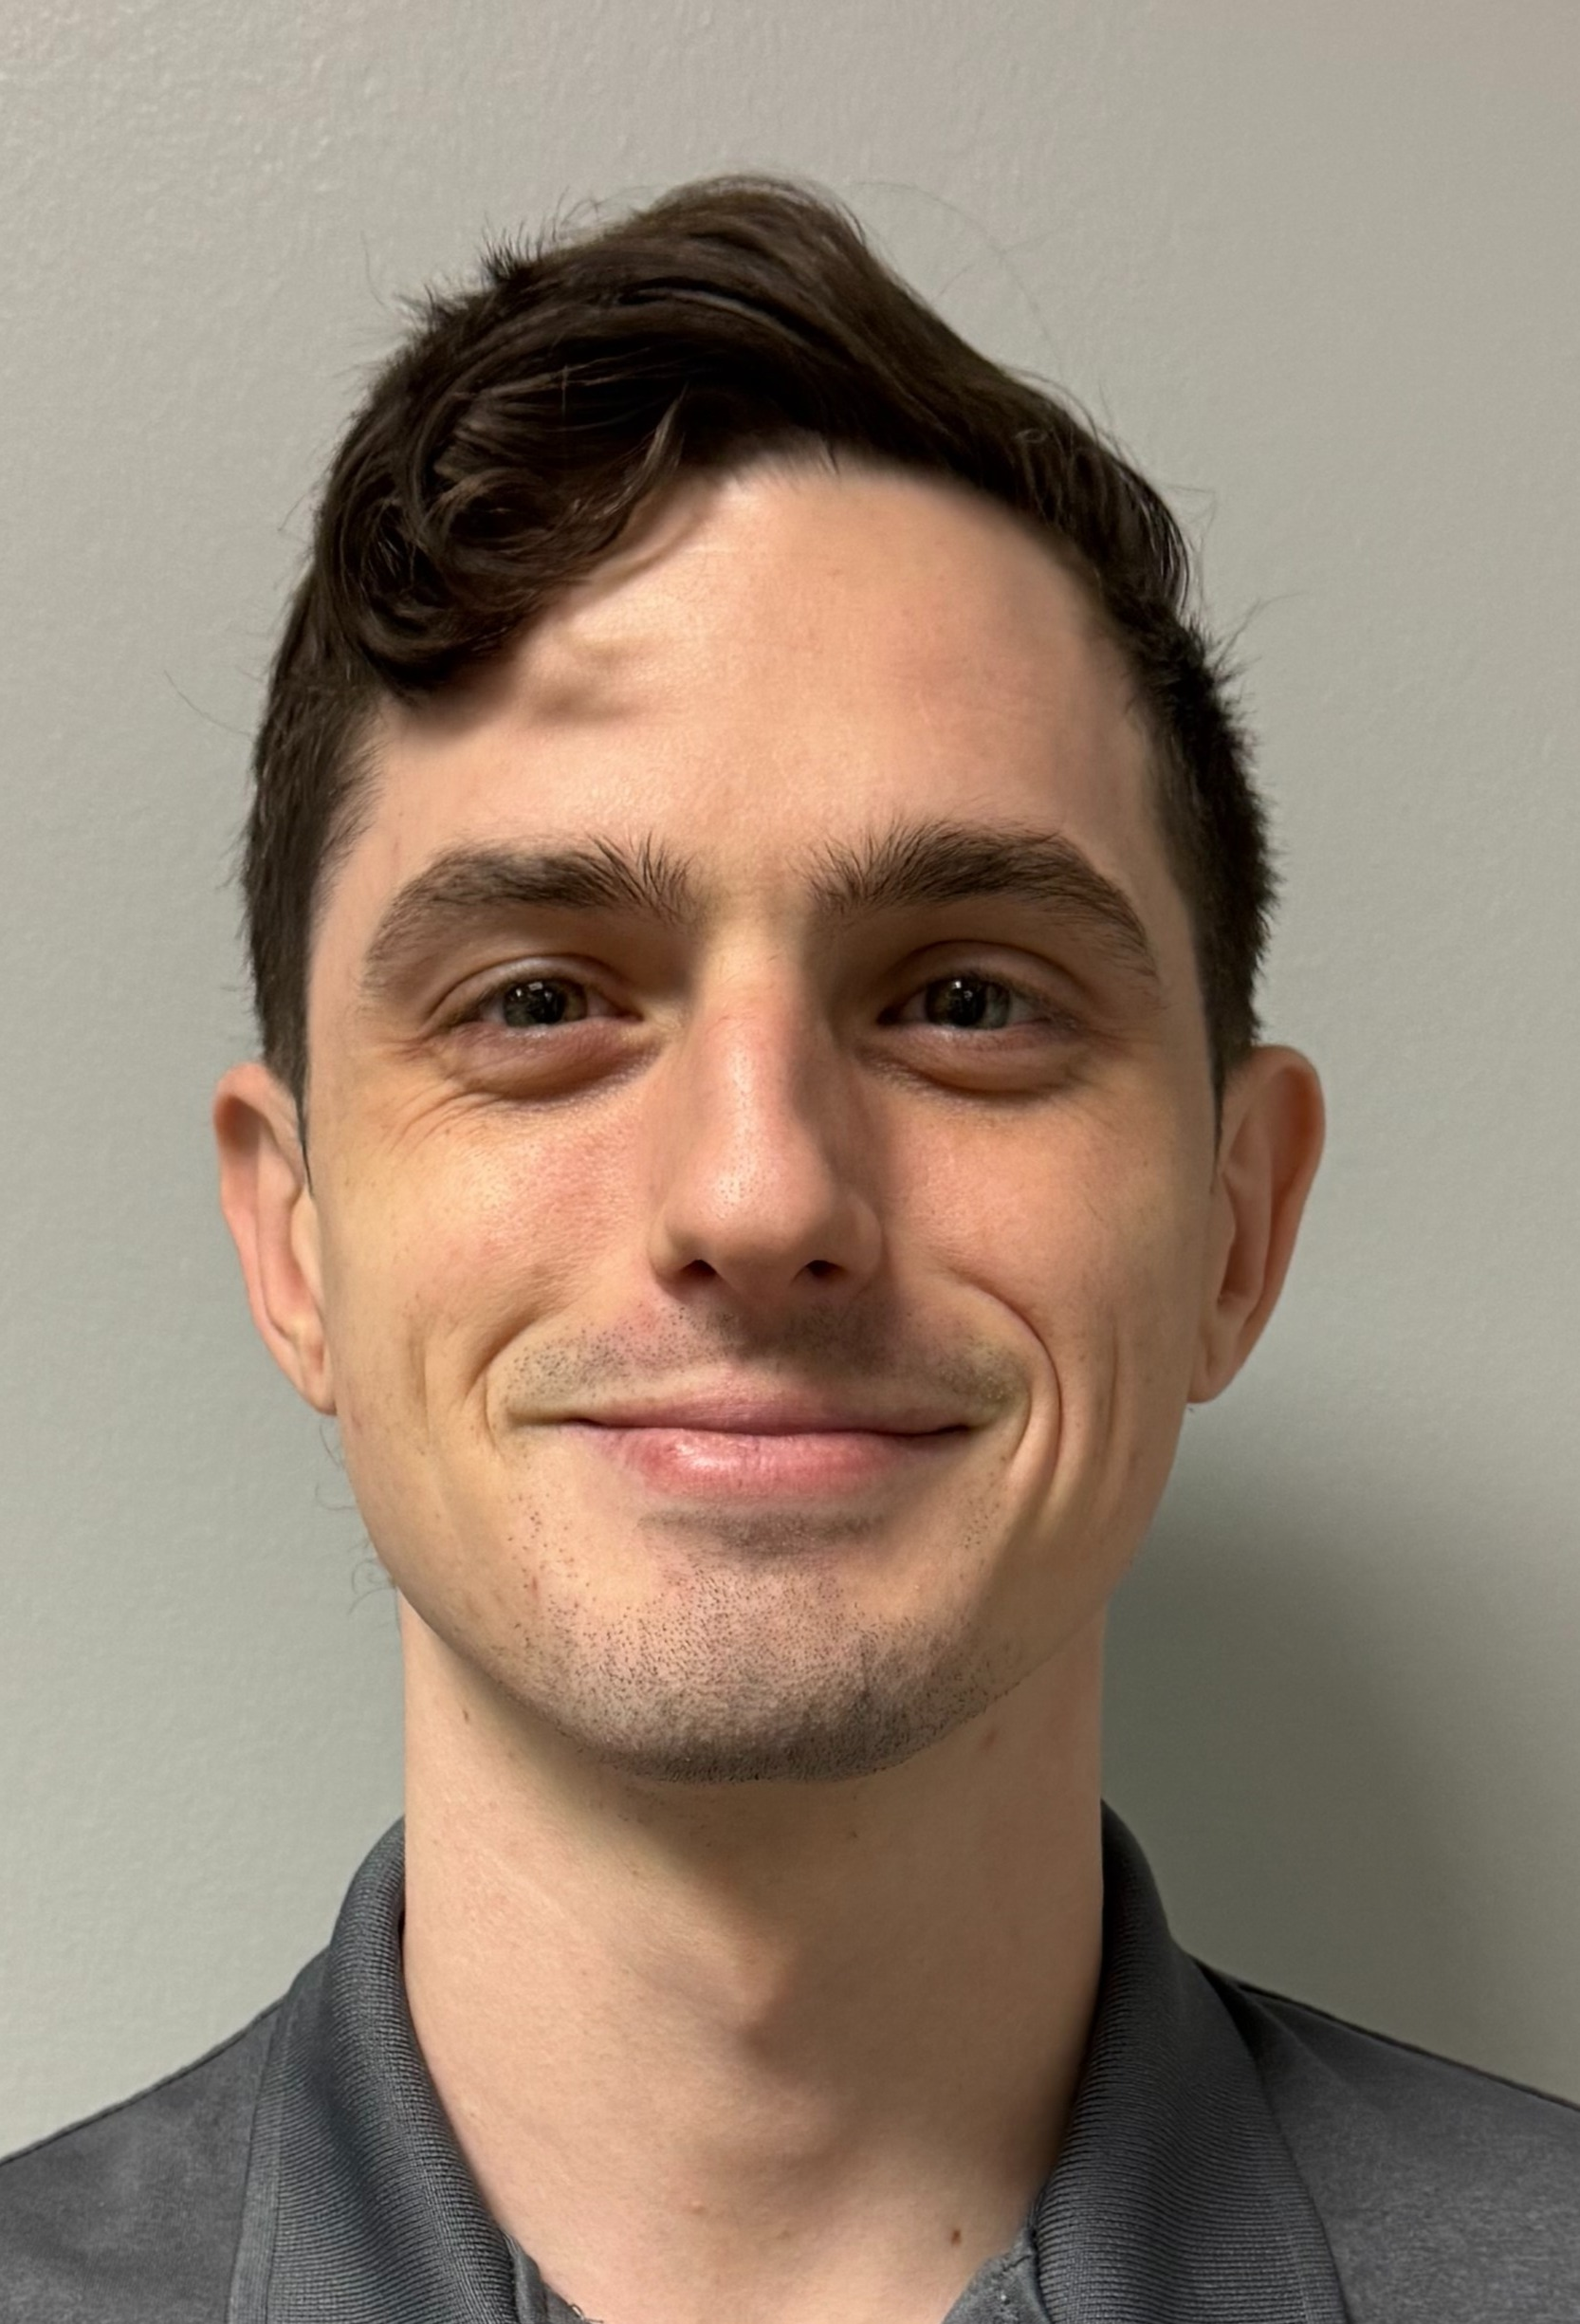
PeopleShores Tech Hub Apprentice
Apprentice Story – Before Apprenticeship (Looking to understand what led you to the Apprenticeship program)
Marine Corps Veteran - Radio Technician
HVAC – Building/installing duct work
Dish Network - Field Technician
Honeywell Inc. - Test Technician
PeopleShores - Jr Data Engineer
My wife and I found out we are going to be first time parents. Needing to find growth for my growing family, I started applying to any and every job tech related. PeopleShores called
Before joining PeopleShores, I was a Tech Technician for Honeywell, Inc which included stress testing circuit cards and replacing components via soldering.
The opportunity to get my foot in the door in a field that is normally attained through a degree is life changing.
Apprentice Story – During Program
I came into this knowing very little about programming. It was intimidating. But my favorite part about this program is the people and support to succeed. I ask a lot of questions, and I have never been turned away or felt like I was asking too many questions.
Additional Info – After Apprenticeship
I learned the fundamentals of programming, how to write code, and solve problems. But more importantly, I will always be a student.
I would highly recommend this program to anyone who has the drive and discipline to learn and advance a new skill in a fast-paced environment that has a huge payout at the end.
Alexander
Truby-Arena
Data Engineer
Tampa ATC
140 Fountain Pkwy N, St. Petersburg, FL 33716
Linkedin
1

Slide 2

Build working programs using Python
Alexander Truby-Arena
Data engineer
RELEVANT SKILLS
RELEVANT EXPERIENCE
Computer Competencies:
Excel, PowerPoint, Word, MySQL, Python, VSCode
Certifications:
EXAMPLE CERTS
Industries:
Development, Technology, Electronics
<Capstone, Per Scholas>
<5/12/2025> - <6/6/2025>
Responsibilities: Create a data pipeline using python as well as a command line interface to easy access the data, then give a detailed presentation on each step of the process.
Contributions: Created the code, researching best practices, develop a PowerPoint presentation, deliver the presentation in an easily understandable and engaging format.
BACKGROUND
Interests: Data Engineering, AI, Cyber Security, Quantum Computing, Post-Quantum Encryption
I have a strong interest in emerging technologies, especially Data Engineering, supported by self-driven learning in AI, Cyber Security, and Quantum Computing through personal study, hands-on practice, and academic exploration.
Studying cybersecurity principles and encryption methods
Researching quantum algorithms and post-quantum cryptography
"A tech-driven problem solver with a passion for secure, intelligent, and future-facing innovation.“
Education/Bootcamp:
Per Scholas Data Engineering Bootcamp
<Data Engineering Bootcamp, PeopleShores>
<5/3/2025> - <6/9/2025>
Responsibilities: Learn and apply core data engineering concepts in a fast-paced environment, build working programs using Python, complete hands-on labs and assessments with a passing grade, demonstrate professionalism through punctuality and active participation.
Contributions: Developed data pipelines and ETL workflows using Python and SQL, collaborated with peers to solve real-world data problems, applied concepts of data wrangling, API integration, and cloud services (i.e., AWS)
<Electronics Maintenance, Marine Corps>
<7/22/2013> - <7/21/2018>
Responsibilities: Performed serialized asset tracking and inventory control for electronic equipment, Repaired and maintained systems including computers, printers, and radios to support mission readiness, ensured operational efficiency and accountability in high-demand, secure environments.
Contributions: Diagnosed and troubleshot malfunctioning electronics under time-sensitive conditions, led and supervised a team of Marines to complete mission-critical repairs, maintained professionalism, order, and discipline while interacting with high-ranking officers under pressure.
CONTACT INFORMATION
Office Location: Tampa ATC
Email: alexander.arena@accenture.com

